Slide 1

Notes:
When our state legislatures take up issues like education, taxes, or response to emergencies, they are doing their best to improve the quality of our lives as individuals and strengthen our state.

Slide 2
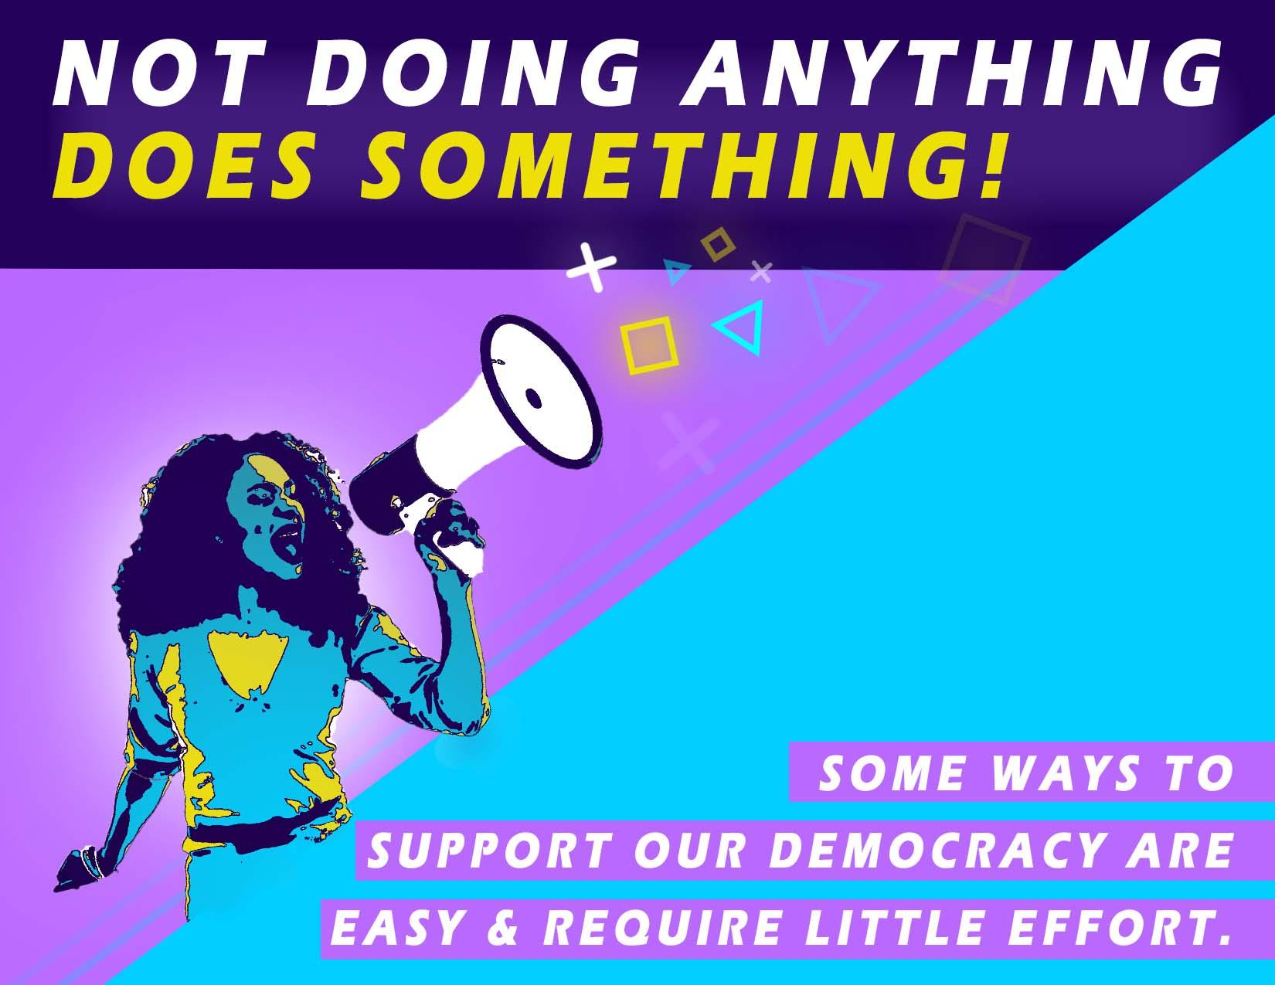
Notes:
What is hard for many people to understand is that in order for representative democracy to work, people must participate. You may share the common belief that a lack of participation has no impact.
But not doing anything, does do something. It saps the energy from democracy, and even worse, allows the views of a few to affect the lives of many. For representative democracy to succeed and continue to solve the problems everyone must actively participate.
Here are some ways to support our democracy are easy and require little effort.

Slide 3

Notes:
Number 1: Vote
While you may not be old enough to vote yet, now is the time to make a commitment to be at the polls EVERY time during your adulthood.
If you think your vote won’t count, think again. We’ve had members of the General Assembly win their election by less than 10 votes.

Slide 4

Notes:
Number 2: Stay informed.
Educate yourself about the issues. The Arkansas legislature live streams all of our meetings. We also keep all the videos on our archive system which is easy to search and navigate.
If you see a post on social media about a candidate or an issue, find the source of the information. Is it from a good and truthful source?
If you have questions about a local issue, you can always contact your representative. You don’t have to wait until you are old enough to vote. In fact, several bills have been introduced over the years by listening to the ideas of students.
Informed voters are those who are active in their communities. Show up at town halls and school board meetings.
Learn about the candidates, the government offices they are running for, and any other key issues in the election.

Slide 5

Notes:
Number 3: Discuss Politics
This does not mean having an "I win, you lose" debate. Rather, discussions are an opportunity to understand another person's position.
Show interest in solutions as well as problems.

Slide 6

Notes:
Number 4: Don’t go it Alone
Join with groups who share your point of view or your passion. The number and diversity of organized interests ensure that all sides of an issue are heard and not that any one group comes out ahead.
Very few people thing about the kinds of laws they’d like to have passed. And those who do give thought to it very rarely convey their ideas to their representatives. As a result, the best way legislators have of knowing what people care about is by checking with the interest groups that focus on the various sides of these issues and are in touch with the views of their membership.

Slide 7

Notes:
Number 5: Be heard
Stay in touch with your elected officials. You can start by doing this today.
On our website www.arkansashouse.org you can put in your address and find your representative. Your ideas are welcome, and they count!

Slide 8
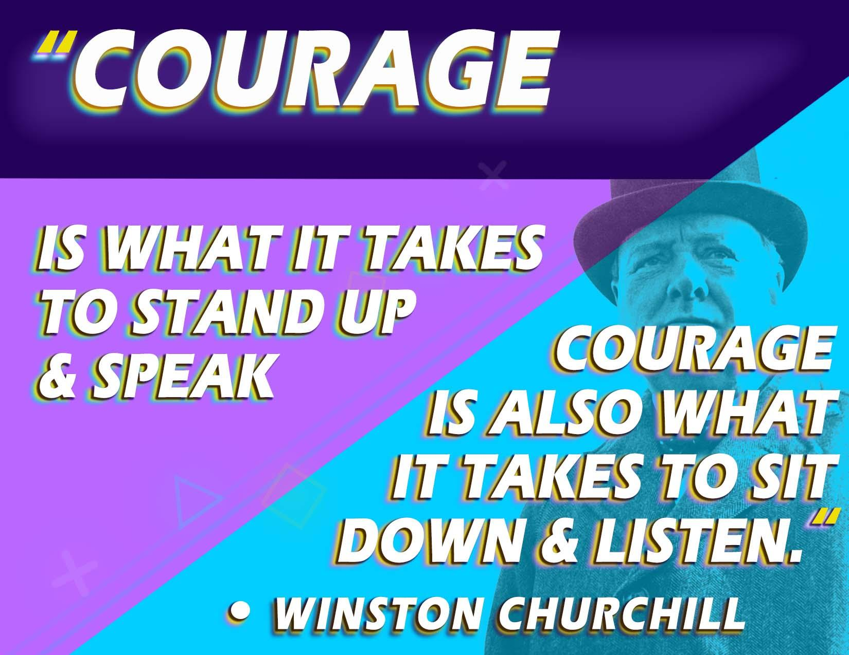
Notes:
The former prime minister of Great Britain, Winston Churchill, once said : Courage is what it takes to stand up and speak; courage is also what it takes to sit down and listen.
We can do both and I look forward to hearing your ideas.

